Slide 1


BLUEPRINT OF AN ESSAY
Writing Support Desk
writingsupport@uwindsor.ca

Slide 2
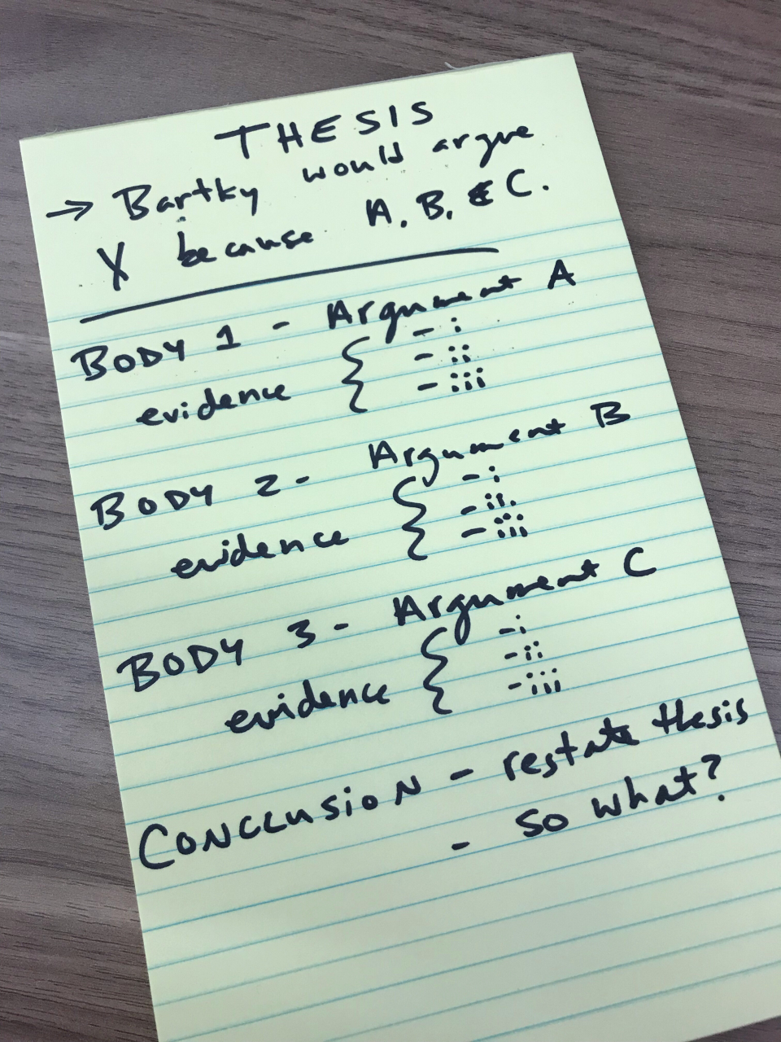
MAP OUT YOUR PAPER
BEFORE YOU START WRITING!

Slide 3

ESSAY MAPPING
Helps to organize thoughts
Avoids the dreaded flashing cursor on a blank page
Easier to rearrange and edit than full paragraphs
Provides an overview of your essay
8

Slide 4
3 PARTS
Introduction
Body Paragraphs
Conclusion

Slide 5
HOOK
INTRODUCTION
OVERVIEW
THESIS
ARGUMENT 1
BODY
ARGUMENT 2
ARGUMENT 3
RESTATE THESIS
CONCLUSION
INTERESTING CLOSING THOUGHT

Slide 6
INTRODUCTION
NARROW TO
SPECIFIC

Slide 7
INTRODUCTION
INTRODUCES TOPIC
STATES ARGUMENT
OUTLINES EVIDENCE

Slide 8
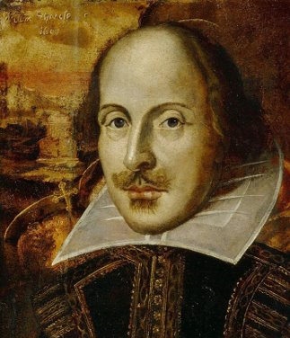
SHAKESPEARE'S ROMEO & JULIET
How could we introduce an essay about this play?

Slide 9
THROUGHOUT HISTORY...

Slide 10
THROUGHOUT
HISTORY,...
Too broad: Shakespeare wrote during the early modern era.

Slide 11
IN EARLY MODERN ENGLAND...

Slide 12
IN EARLY MODERN ENGLAND...
Too broad: Lots of people wrote plays in early modern England.

Slide 13
IN SHAKESPEARE'S PLAYS...

Slide 14
IN SHAKESPEARE'S PLAYS...
Too broad: Shakespeare wrote more than 30 plays in his life.

Slide 15
SHAKESPEARE'S ROMEO & JULIET SUBVERTS GENDER ROLES IN VARIOUS WAYS...

Slide 16
SHAKESPEARE'S ROMEO & JULIET SUBVERTS GENDER ROLES IN VARIOUS WAYS...
NARROWS TOPIC &
INTRODUCES IT CLEARLY

Slide 17
HOOK
OVERVIEW
THESIS

Slide 18
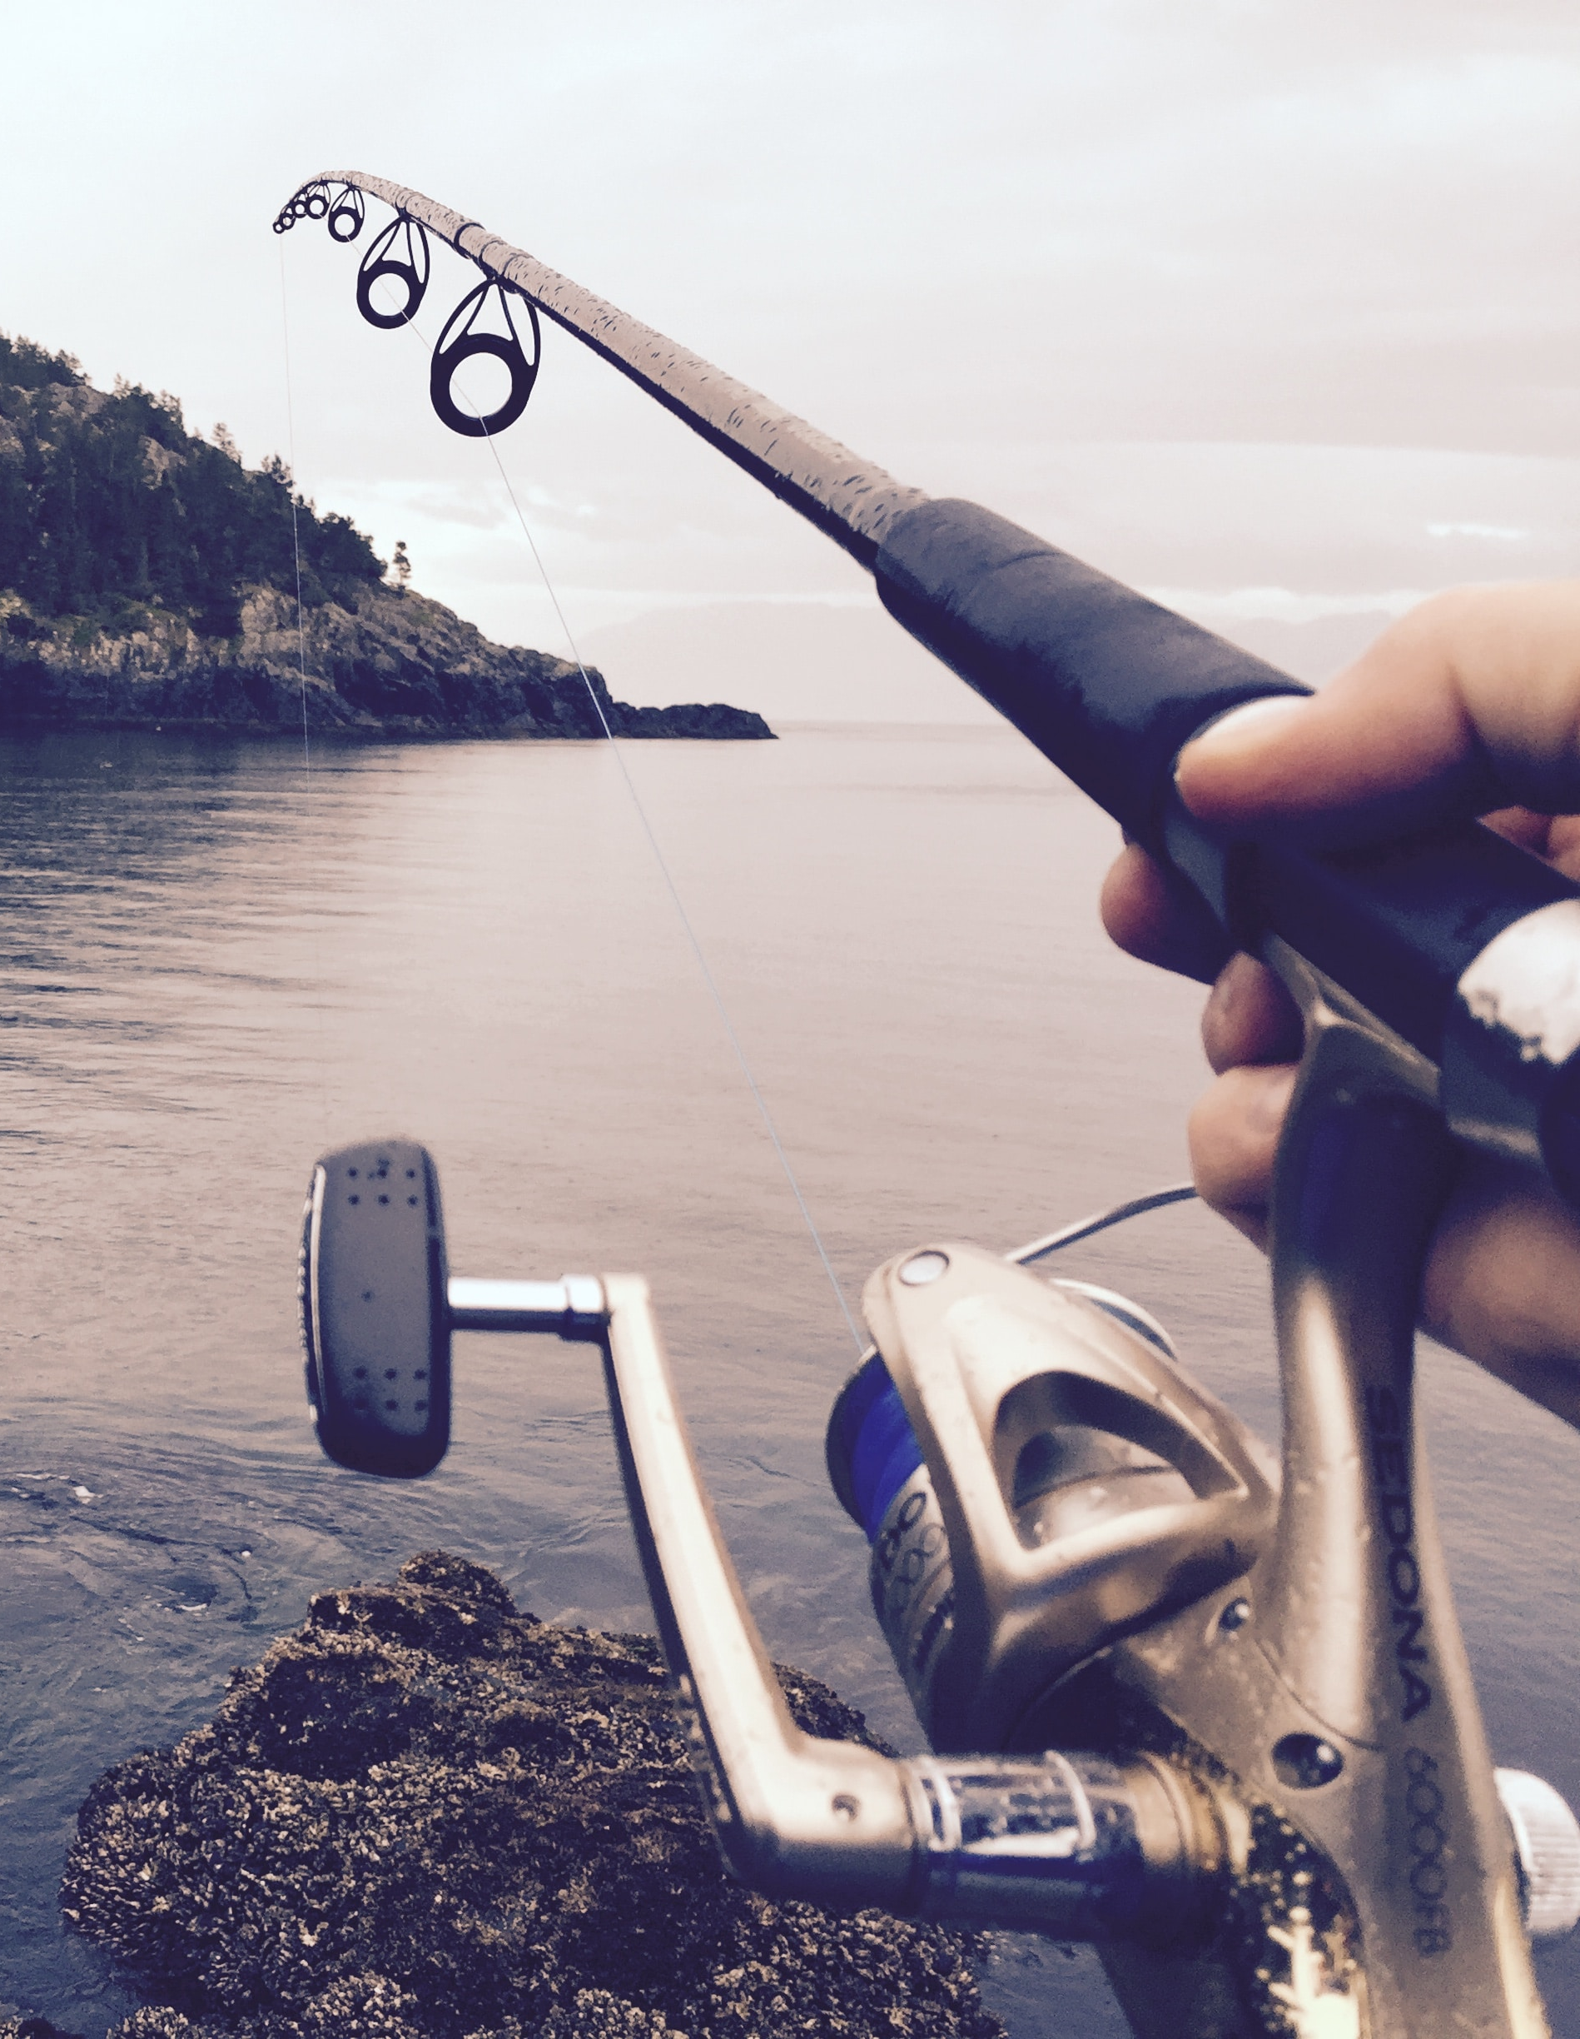
A HOOK GRABS ATTENTION
statistic
(Over half of Americans die of heart disease)
unconventional position
(The education system should not promote equality; rather, it should promote equity)
rhetorical question
(Should animals be protected by law?)
8

Slide 19
A HOOK GRABS ATTENTION
quotation
"Education is the most powerful weapon" according to Nelson Mandela.
definition
Equity is defined as "a situation in which everyone is treated fairly and equally"
8

Slide 20

PROVIDE AN OVERVIEW OF EVIDENCE
PRO TIP! Don’t go into too much detail. Save that for the body paragraphs.
What are the main points you will be using to defend your thesis?
This overview provides a road map to your paper!
8

Slide 21
YOUR ENTIRE PAPER
WORKS TO PROVE
YOUR
THESIS
WHAT IS YOUR PAPER
ARGUING OR
TRYING TO PROVE?
A CLEAR THESIS
IS ESSENTIAL TO
A CLEAR PAPER!

Slide 22
BUILD-A-THESIS
WHO? people involved
WHAT (SUBJECT)? the subject
WHAT (ARGUMENT)? your position
WHEN? time/era if relevant
WHERE? location if relevant
WHY? reasoning/purpose
HOW? your methods

Slide 23
BUILD-A-THESIS
WHO?
WHAT (SUBJECT)?
WHAT (ARGUMENT)?
WHEN?
WHERE?
WHY?
HOW?
students
online learning
Online learning exposes inequities among students
now
Canada
To understand relationship between online learning & equity
an analysis of literature

Slide 24
THESIS
A review of literature suggests that online learning exposes systemic inequities between Canadian students.
OVERVIEW OF EVIDENCE
Evidence suggests that inequitable access to computers and other technology, adequate workspace, and regular contact with instructors can create barriers for low-income and marginalized students.

Slide 25
BUILD-A-THESIS: YOUR TURN!
WHO?
WHAT (SUBJECT)?
WHAT (ARGUMENT)?
WHEN?
WHERE?
WHY?
HOW?
home healthcare nurses
patient health teaching
can reduce hospital re-admissions
now
in the home/community
to improve patient outcomes
a review of literature

Slide 26
BUILD-A-THESIS: YOUR TURN!
A review of literature suggests that home healthcare nurses can reduce hospital re-admissions through in-home and community patient health teaching.

Slide 27
BODY PARAGRAPHS
ARGUMENT 1
BODY
ARGUMENT 2
ARGUMENT 3

Slide 28
ARGUMENT 1
TOPIC SENTENCE
EVIDENCE
ANALYSIS
CONCLUSION

Slide 29
TOPIC SENTENCE: A MINI THESIS!
Tells the reader what the paragraph is about (specific topic)
Links this topic/argument to the thesis
Avoids providing particular evidence (that comes later!)
Lack of access to computers and reliable internet is a major barrier to online education for students of low socioeconomic status.
8

Slide 30
EVIDENCE: PROVE IT!
9% of children in Canada live below the poverty line, and nearly 14% of households with children lack reliable internet access.
Raw data that backs up your topic sentence (and in turn your thesis)
Facts, stats, quotes, arguments from sources, etc.
Context is important!
8

Slide 31
ANALYSIS: WHAT DOES IT MEAN?
This suggests that there is a large number of students for whom online learning may be completely inaccessible, which may negatively impact their education.
Apply your evidence to the topic to suggest implications
Critical thinking & making connections!
8

Slide 32
CONCLUSION: TIE IT TOGETHER
The barriers posed by limited technological access therefore suggest that mandating online learning exacerbates existing class marginalization.
Link your analysis to your thesis
Critical thinking & making connections
Tie the paragraph together, so you are ready for your next body paragraph to begin
37

Slide 33
ARGUMENT 2
TOPIC SENTENCE
EVIDENCE
ANALYSIS
CONCLUSION

Slide 34
ARGUMENT 2
REPEAT FOR EACH
BODY PARAGRAPH
TOPIC SENTENCE
EVIDENCE
ANALYSIS
CONCLUSION

Slide 35
SPECIFIC TO FORWARD LOOKING
CONCLUSION

Slide 36
RESTATE
THESIS IN
A DIFFERENT WAY
EVIDENCE RECAP
SO WHAT?
INTERESTING FINAL THOUGHT
CONCLUSION

Slide 37
IN
CONCLUSION,
...

Slide 38
INTERESTING CLOSING THOUGHTS
Suggestions for future research/ predictions "future research should consider what additional barriers may intersect with SES"
Suggestions for practical applications and value "...by considering these barriers, educators may identify ways to improve access..."
Broader implications / so what? "Understanding the way SES contributes to learning can increase access to equitable education..."
40

Slide 39
HOOK
INTRODUCTION
OVERVIEW
THESIS
ARGUMENT 1
BODY
ARGUMENT 2
ARGUMENT 3
RESTATE THESIS
CONCLUSION
INTERESTING CLOSING THOUGHT

Slide 40



IT'S TIME TO WRITE!
4

Slide 41
QUESTIONS?
Remember, this slideshow and many others are available to download via the Writing Support Brightspace page.
Students can self-enroll as 'learners' either by selecting 'Discover' from the Brightspace landing page and clicking 'Enroll' on the Writing Support organization.

